Slide 1
Web Scraping and Analysis using python
by-
Souvik Bhattacharyya

Slide 2
Contents
Abstract
Data Scrapping using beautifulsoup and requests.
Code overview (Scrapping, Cleaning, and Visualization)
Visualization
Conclusion

Slide 3
Abstract
In this assignment, we will scrap data from the given website by using python modules like Bs4(beautifulsoup) and requests. And try to extract all the necessary data from the website so that we can analyze the dataset and get information about it.
After extracting data from the given website we have to clean unwanted data or fix the missing values and make unstructured data into a structured format using pandas data frame with the help of the created data frame we can easily visualize the dataset using python modules like matplotlib, seaborn, etc.

Slide 4
Data Scrapping using beautifulsoup and requests.
We have extracted the URL -'https://opentender.eu/start’ which has data names as a country and their number of tenders with the help of beautifulsoup by requesting to get permission from the website using the request command and extracting the data which is in unstructured data. We converted it into a structured format by providing column names and with the help of pandas, we converted it into a data frame.

Slide 5
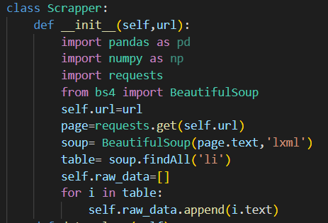
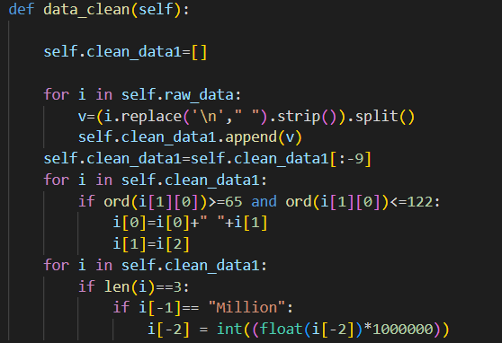
Code overview (Scrapping, Cleaning, and Visualization)
Scrapping
Data Cleaning

Slide 6
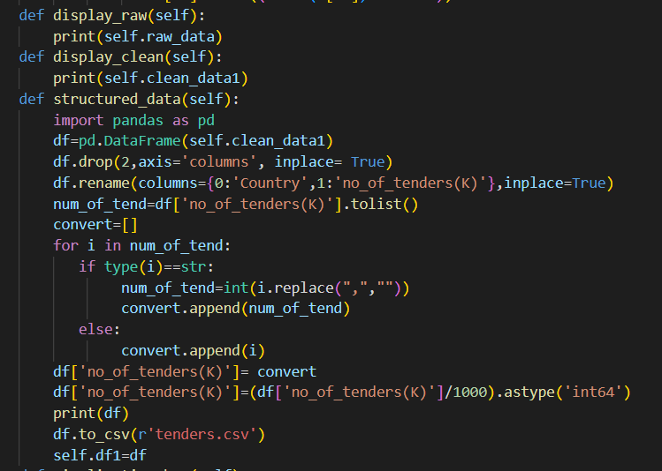
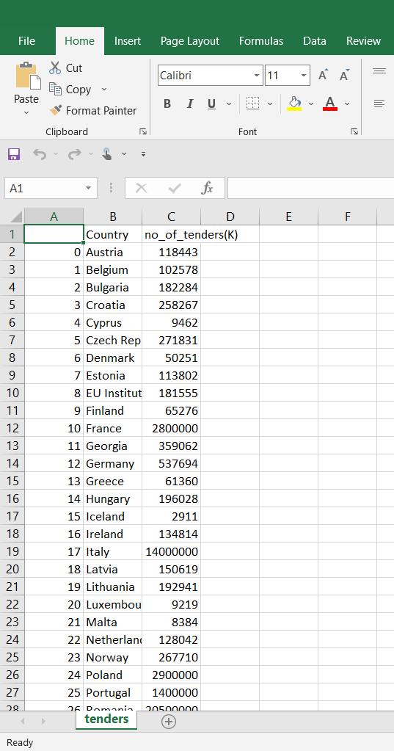
Code overview (Scrapping, Cleaning, and Visualization)
Display Raw data
Display Cleaned Data
Display Structured Data
Save DataFrame into csv format

Slide 7
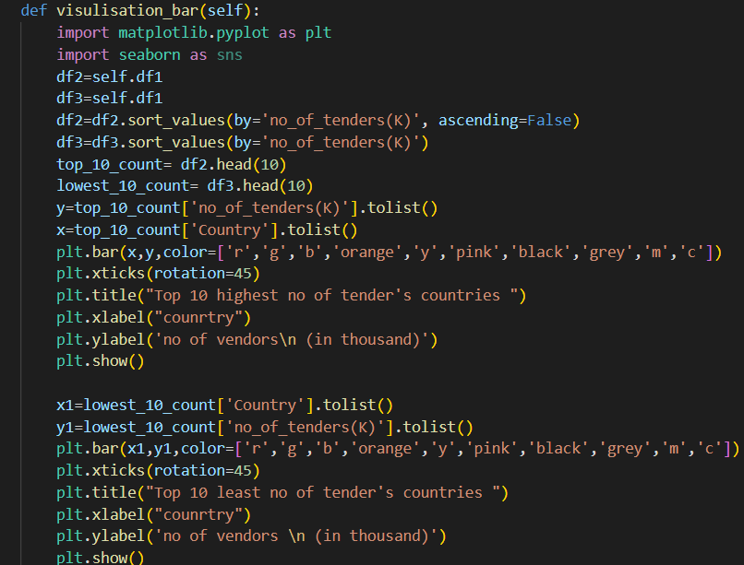
Code overview (Scrapping, Cleaning, and Visualization)
Data Visualization Code

Slide 8
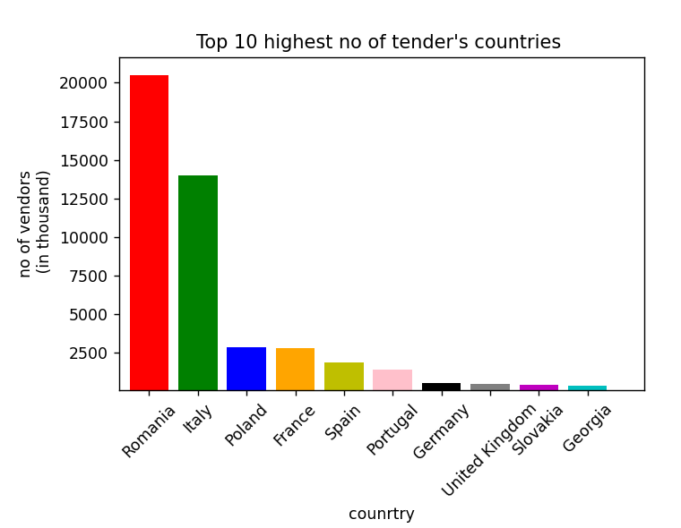
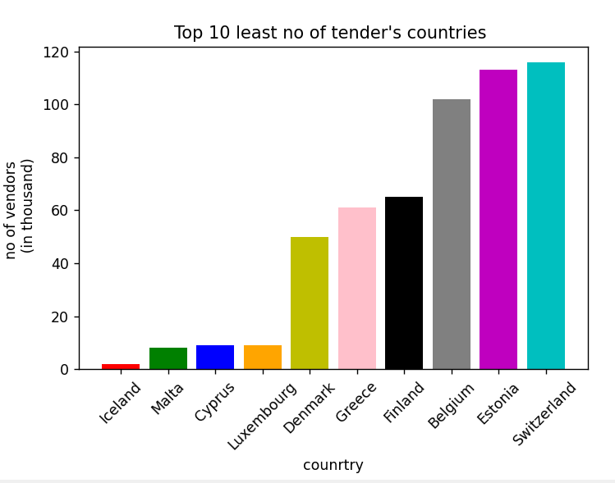
Visualization
Top 10 least no of tender’s countries
Top 10 least no of tender’s countries
We can visualize with the help of a graph that Romania has the highest number of tenders in the world followed by Italy, Poland, France, Spain, Portugal, etc. And the lowest number of tenders is from Iceland followed by Malta, Cyprus, Luxembourg, Denmark, Greece, etc.

Slide 9
Conclusion
The research concluded that with the creation of data points for the countries with a number of tenders by extracting them from the website which is in an unstructured format and converting them into structured data points in a form of a Dataframe that can be stored in a comma separated value (CSV) format.
After creating Dataframe we analyzed which countries have the maximum number of tenders and countries which have the least number of tenders.

Slide 10
THANK YOU

